Slide 1
Delta vs. Omicron
How different is Omicron from Delta?
Under Supervision of:
Dr. Ibrahim Mohamed Youssef, PhD

Slide 2


First reported?
DELTA
OMICRON

Slide 3


Data??
10 Sequences → Delta “Reference”
10 Sequences → Omicron “Case”
Source country: Ghana

Slide 4


Methods & Tools
Multiple alignment
Phylogenetic tree
Consensus Sequence
Dissimilar Regions
Chemical Constituents

Slide 5
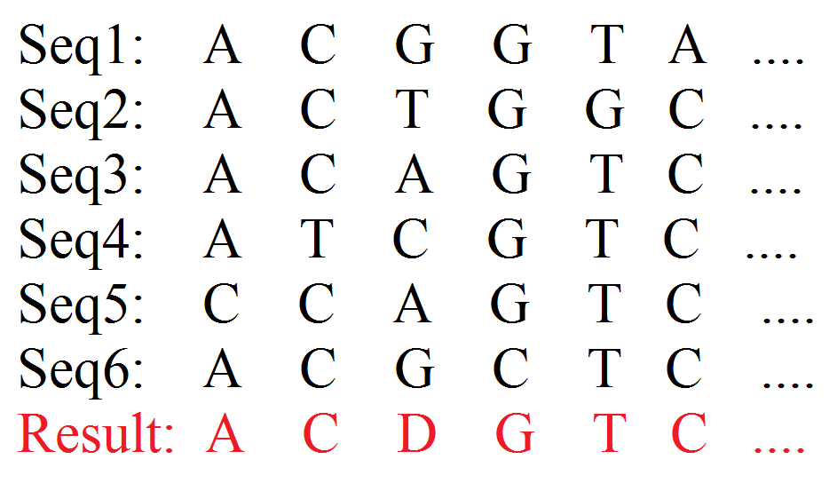
Procedure
Getting a single representation for the reference sequences.” consensus sequence”
Multiple alignment between case sequences.
Phylogenetic tree between all 20 sequences.
C, G, A, T, CG contents calculation for all sequences.
Dissimilar regions extraction.
Example for the representative sequence at 70% threshold.

Slide 6
Procedure
Constructing the Consensus Sequence (Python)
Representative sequence
Computed from Reference sequences
How?
Dominant Nucleotides

Slide 7
Procedure
Multiple alignment between Case Sequences
Phylogenetic tree for all 20 sequences
Done using MEGA

Slide 8
Procedure
4. C, G, A, T, CG contents calculation for all sequences (Python)
Example:
ACCCTGATGC
C Content = 4/10 (*100)
G Content = 2/10 (*100)
T Content = 2/10 (*100)
A Content = 2/10 (*100)
CG Content = (4+2)/10 (*100)

Slide 9
Procedure
5. Dissimilar regions extraction (Python)
- 70% minimum threshold of repetition
Example for the representative sequence at 70% threshold.

Slide 10
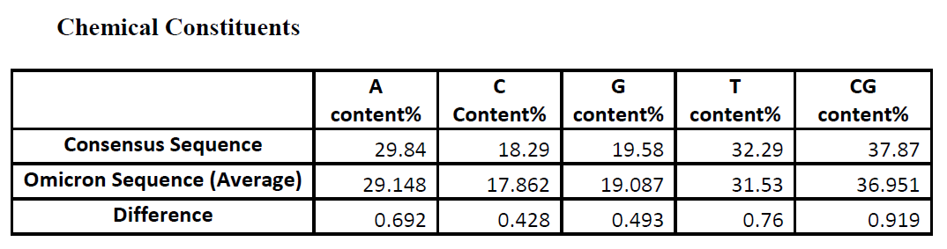
Result

Slide 11
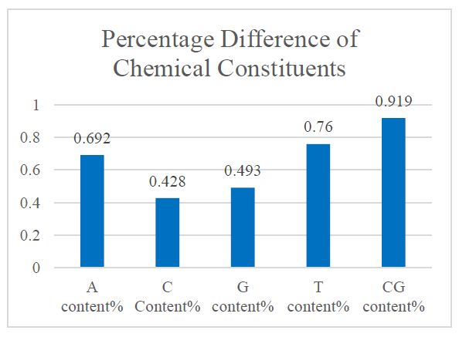
Result (cont.)

Slide 12
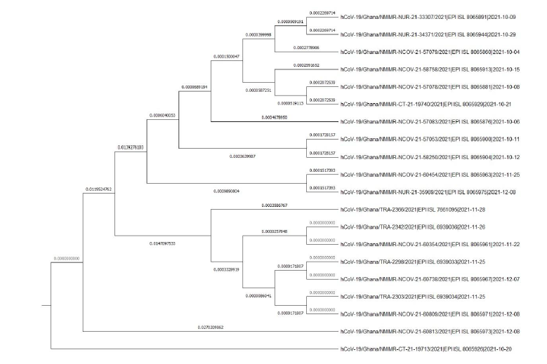
Result (cont.)

Slide 13
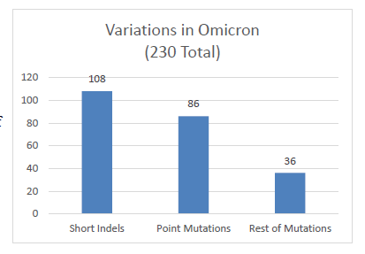
Result (cont.)

Slide 14
Conclusion
The Omicron variant is not so different from the Delta variant
2. The vaccine might be found in a very similar way as for Delta

